Slide 1


INFT 1012 Network Fundamentals
Week 2 – Topic Outline and Highlights

Slide 2
Topic
Protocols and Models
Rules of Communication
Network Protocols and Standards
Reference Models
Data Transfer in the Network
Data encapsulation
Addresses

Slide 3
Readings
CCNAv7: Introduction to Networks course text & quizzes
Module 3
Available at: www.netacad.com

Slide 4
Protocols and Models
Highlights

Slide 5
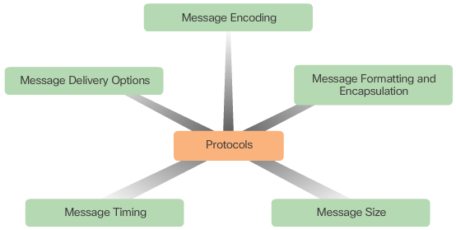
Rules of Communication & protocols
Computer networks are systems of end devices, intermediary devices, and the media connecting them. For communication to occur, devices must know the rules on “how” to communicate.
These rules are defined as Protocols.
A common network communication protocol specifies rules in one or more of the five aspects shown in the diagram.
Note: Additionally, there are protocols especially designed for securing networks (security protocols), for routers to exchange route information (routing protocols) and for detecting devices or services (service discovery protocols)

Slide 6
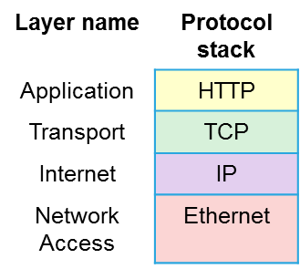
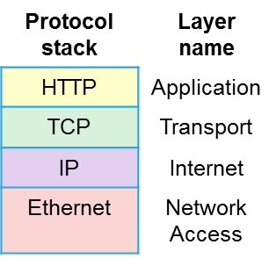



Protocol Interactions & Protocol Suites
A message sent over a network typically requires the use of several protocols, each one with its own functions and format.
Example: Interaction of protocols in the communication between a web client and web server.
A group of inter-related protocols necessary to perform a communication function is called a protocol suite.
One of the best ways to visualize how the protocols within a suite interact is to view the interaction as a stack.
The protocols are viewed in terms of layers, with each higher level service depending on the functionality defined by the protocols shown in the lower levels.

Slide 7
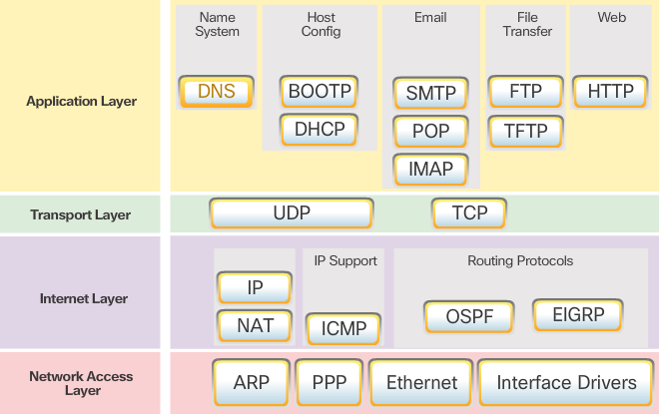
TCP/IP Protocol Suite
TCP/IP is the protocol suite used by the Internet and the networks of today.
A standards-based protocol suite, endorsed by the networking industry and approved by a standards organization. This ensures that products from different manufacturers can interoperate successfully.
An open standard protocol suite, freely available to the public and can be used by any vendor on their hardware or in their software.
The TCP/IP protocol suite includes many protocols and continues to evolve. This course will cover the main protocols of the TCP/IP protocol suite

Slide 8
Reference models
A reference model is a networking model used when discussing network functionality
The OSI (Open Systems Interconnection) model and the TCP/IP model are the two primary reference models, developed by ISO (International Organization for Standardization) and IETF (Internet Engineering Task Force) respectively
Both OSI and TCP/IP models are layered networking models, and they describe what has to be done at a particular layer, but not prescribing how it should be accomplished
A reference model does not describe any specific protocol at a protocol layer. It is an abstraction or conceptual model of protocol functions. This is different from a protocol stack, which is also organized into layers, but it is the suite/stack of specific protocols

Slide 9
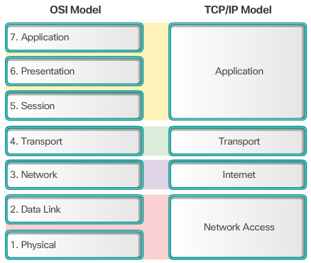
OSI Model and TCP/IP Model
Key similarity: Transport layer and Network/Internet layer
TCP/IP application layer protocols may implement functions specified in one or more of the top 3 layers of the OSI model
The OSI model separates the data link layer from the physical layer (So these two OSI layers, instead of the Network Access layer of TCP/IP, are more commonly referred to when people talking about these lower layers.)

Slide 10
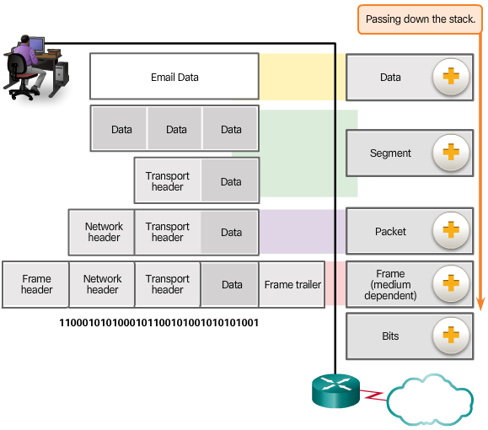
Encapsulation
When sending a message, as application data is passed down the protocol stack on its way to be transmitted across the network media, various protocol information is added at each level. This is known as the encapsulation process.
The information added at each layer is known as “header” or “trailer” depending on where the information is added.
Encapsulation process works from top to bottom. Each layer (layer N) considers its upper layer (layer N+1) PDU as data and encapsulates the data in the current layer protocol’s PDU by adding header and/or trailer according to the protocol’s format, and passes the PDU to the layer below (layer-N-1).
Web Data
Application Layer
Transport Layer
Network Layer
Data Link Layer
Physical Layer
PDU - Protocol Data Unit, the form that a piece of information takes at any layer
Notes:
Note: in the diagram above, immediately below “Web Data”, we see three blocks of “Data” to be encapsulated at the transport layer. This is because the web data may be too big, the transport layer protocol, e.g. TCP, firstly cuts/segments the web data into three pieces, and then encapsulates each piece of the Data by adding transport header to it. After encapsulating each piece of data, TCP passes it down to the Network layer.

Slide 11

PDU – Protocol Data Unit
At each stage of the process, a PDU has a different name to reflect its new functions:
Data – application layer
Segment – transport layer
Packet – network layer
Frame – data link layer
Bits – physical layer
Web Data
Application Layer
Transport Layer
Network Layer
Data Link Layer
Physical Layer
PDU - Protocol Data Unit, the form that a piece of information takes at any layer

Slide 12
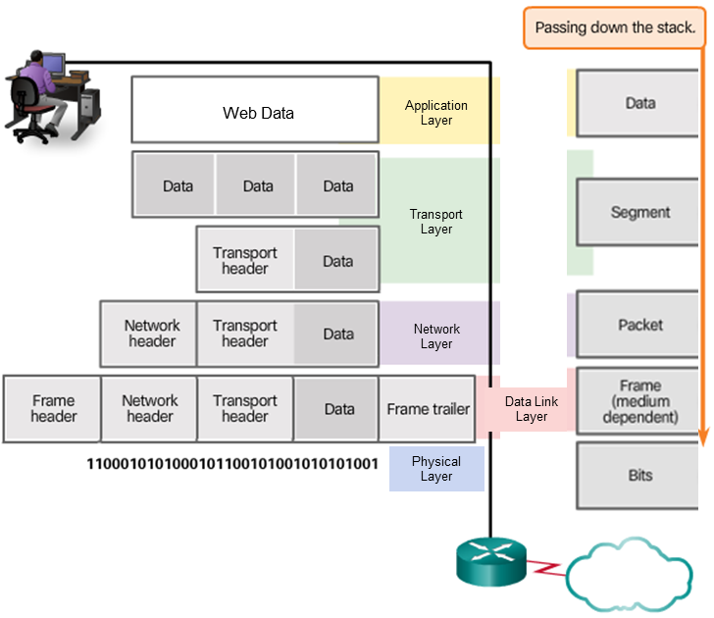
Encapsulation - Example
For example, a web client sends information (a request) to a web server
Major protocols involved:
HTTP at application layer
TCP at Transport layer
IP at Network layer
Ethernet at Data Link layer
Encapsulation process
Transport header
Network header
Frame header
Frame Trailer
TCP receives an HTTP message from application layer, treats the message as the Data part of TCP, adds to it TCP header (transport layer header) to form a TCP segment, and passes the segment to IP
IP receives a TCP segment, treats the segment as IP’s data, adds to it IP header (network layer header) to form an IP packet, and passes the packet to Ethernet
Ethernet receives the IP packet, treats the packet as Ethernet’s data, adds to it Ethernet frame header and frame trailer, to form an Ethernet Frame, and passes the frame to physical layer, to be converted to signals to go out
Notes:
Note: in the diagram above, immediately below “Web Data”, we see three blocks of “Data” to be encapsulated at the transport layer. This is because the web data may be too big, the transport layer protocol, e.g. TCP, firstly cuts/segments the web data into three pieces, and then encapsulates each piece of the Data by adding transport header to it. After encapsulating each piece of data, TCP passes it down to the Network layer.

Slide 13
De-Encapsulation
De-encapsulation is the reverse process at the receiving host, going from bottom to top.
Continue with the previous example, the de-encapsulation process at the web server that receives the request from the client:
Ethernet at Data Link Layer receives the Ethernet frame from physical layer, checks the frame header and trailer. After confirming that the frame is received ok and is for itself, removes the frame header and trailer (or in other words, de-encapsulates the IP packet) and passes the packet to IP at Network Layer.
IP gets the packet, checks IP header and confirms that the packet is ok and it is for the server, removes IP header or de-encapsulates the TCP segment and passes the segment to TCP at transport layer.
TCP gets the segment, checks TCP header and knows that it is for HTTP, and then removes the TCP header or de-encapsulates the HTTP request and passes the request to HTTP at application layer to be processed.

Slide 14
Network Layer Addresses & Data Link Layer Addresses
Network and data link layers are responsible for delivering data from the source device to the destination device.
Protocols at both layers contain a source and destination address, but their addresses have different purposes.
Network layer addresses - Responsible for delivering an IP packet from the original source to the final destination, either on the same network or a remote/different network.
Data link layer – Responsible for delivering a data link frame from one network interface card (NIC) to another NIC on the same network.
IP addresses are network layer addresses for the Internet.
On an Ethernet network, the data link addresses are known as MAC (Media Access Control) addresses.

Slide 15
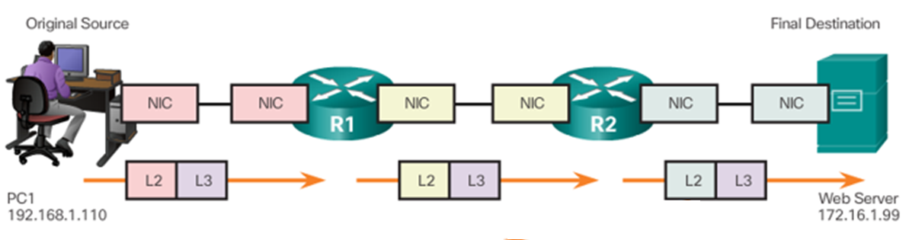
Network Layer Addresses & Data Link Layer Addresses
IP addresses in an IP packet do not change when the packet is delivered all the way to the final destination.
Before an IP packet is sent over a network, it must be encapsulated in a data link frame to be transmitted over the physical medium.
As the IP packet travels from host-to-router, router-to-router, and finally router-to-host, at each hop along the way the IP packet is encapsulated in a new data link frame with different source and destination data link addresses.

Slide 16
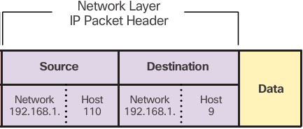
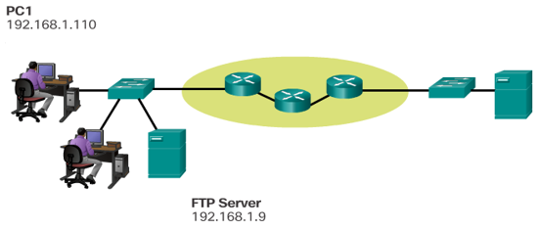
Data Transfer Between Devices on The Same Network
Example: Client computer, PC1, sending a message to FTP server.
Source: PC1 with IP address 192.168.1.110.
Destination: FTP server with IP address 192.168.1.9.
The network (left) portion of the source and destination IP addresses are the same: 192.168.1.x, indicating they are on the same IP network

Slide 17
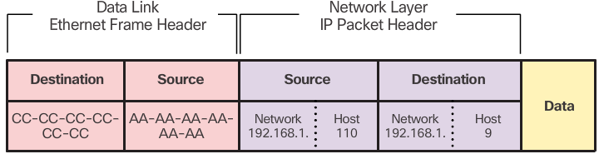
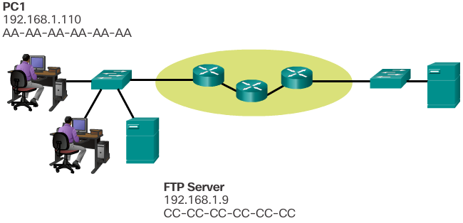
Data Transfer Between Devices on The Same Network
Example - continued
After PC1’s data link layer receives the IP packet from PC1’s network layer, data link layer encapsulates the packet into an Ethernet frame (data link layer frame)
Source MAC address (PC1’s NIC): AA-AA-AA-AA-AA-AA
Destination MAC address (FTP server’s NIC): CC-CC-CC-CC-CC-CC
Because the sender (PC1) and receiver (FTP server) of the IP packet are on the same network, the data link frame is sent directly to the receiving device.

Slide 18
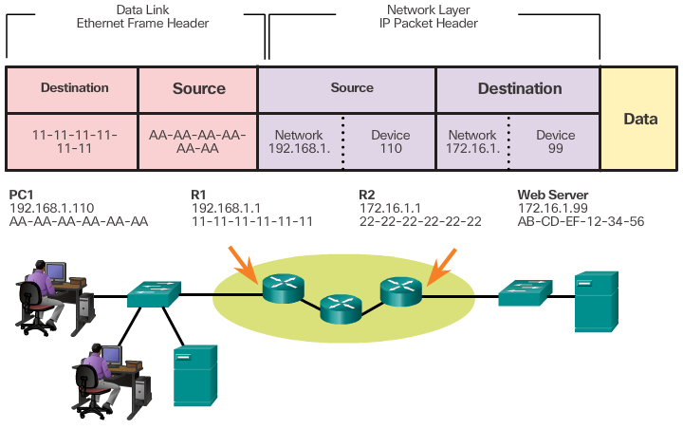
Devices on a Remote Network
When the sender and receiver are on different networks, the Ethernet frame cannot be sent directly to the final destination.
The Ethernet frame must be firstly sent to the default gateway of the sending device.
The default gateway of a device is the interface of the router that is connected to the device’s network.
Example: PC1 sends a message to the web server. They are not in the same network, so in the frame sent by PC1, the destination MAC address is the address of its default gateway, R1, which is 11-11-11-11-11-11.
Notes:
PC1 wants to send a message to the web server (assuming all the links using Ethernet connections):
1. PC1 finds out the network portion of the webserver’s IP address (172.16.1.x) is different from its own (192.16.1.x), and PC1 knows the webserver is on a different network
2. When PC creates the Ethernet frame to encapsulate the IP packet to be sent to the webserver, it uses its default gateway R1’s left interface’s MAC address (11-11-11-11-11-11) as the destination address for the frame, and sends it out
3. R1 receives this frame, and finds out the MAC address of the next hop, i.e. the MAC address of middle router’s left interface, and create the frame with new source MAC address (middle router’s right interface’s MAC address) and destination MAC addresses (right router’s left interface’ MAC address)
4. The middle router will do the same thing as R1 does to send the encapsulated packet to R2, the webserver’s default gateway.
5. After R2 receives the frame, it creates a new frame to encapsulate the packet. The source MAC address of the frame is R2’s right interface (web server’s default gateway)’s MAC address, and the destination MAC address is the webserver’s MAC address.
6. The frame is sent from R2 to the webserver!

